Slide 1
PageRank: Part 1
The Random Walk Model

Slide 2
Random Walks on the Web

Slide 3
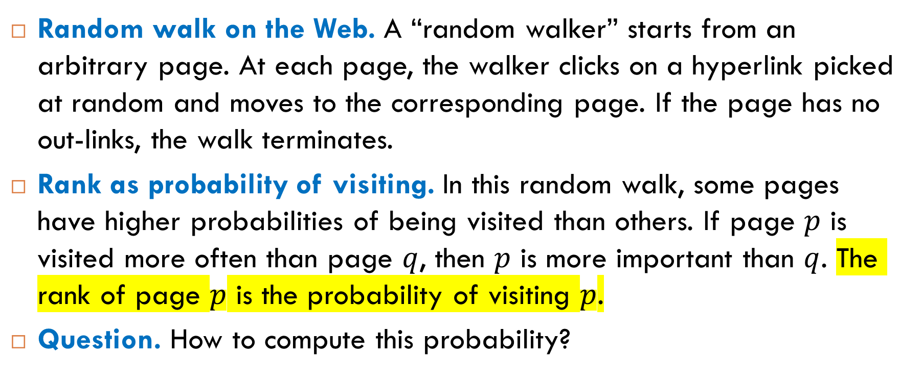
Idea of Ranking
Random walk on the Web. A “random walker” starts from an arbitrary page. At each page, the walker clicks on a hyperlink picked at random and moves to the corresponding page. If the page has no out-links, the walk terminates.
Rank as probability of visiting. In this random walk, some pages have higher probabilities of being visited than others. If page $p$ is visited more often than page $q$, then $p$ is more important than $q$. The rank of page $p$ is the probability of visiting $p$.
Question. How to compute this probability?

Slide 4
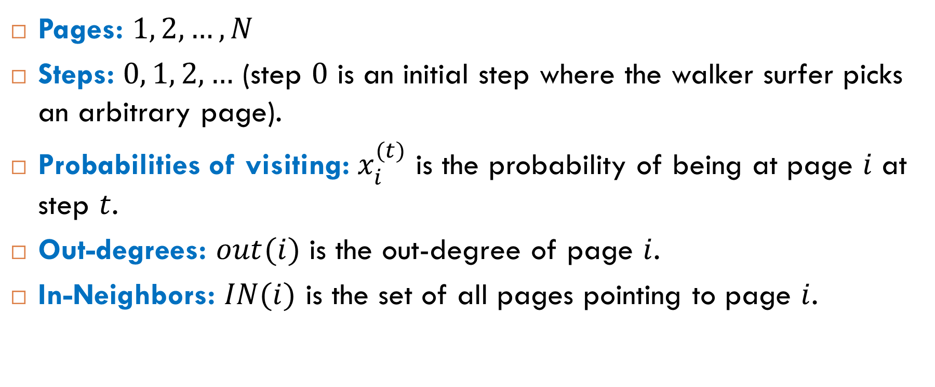
Notation Used to Describe the Model
Pages: $1, 2, …, N$
Steps: $0, 1, 2, …$ (step $0$ is an initial step where the walker surfer picks an arbitrary page).
Probabilities of visiting: $x_{i}^{(t)}$ is the probability of being at page $i$ at step $t$.
Out-degrees: $out(i)$ is the out-degree of page $i$.
In-Neighbors: $IN(i)$ is the set of all pages pointing to page $i$.

Slide 5


Example
Fragment of the Web: three pages with incoming and outgoing links:
Question. Suppose we know the probabilities of visiting pages $1$ and $2$ at step $t$. How to find the probability of visiting page $3$ at step $t+1$?
$$x_{1}^{(t)}=0.5$$
$$x_{2}^{(t)}=0.3$$
$$x_{3}^{(t+1)}= ?$$

Slide 6


Example: Answer
We can find $x_{3}^{(t+1)}$ using the formula of total probability:
$$x_{3}^{(t+1)}=\frac{1}{2}⋅0.5+ \frac{1}{3}⋅0.3=0.35$$
$$x_{1}^{(t)}=0.5$$
$$x_{2}^{(t)}=0.3$$
$$x_{3}^{(t+1)}= ?$$

Slide 7
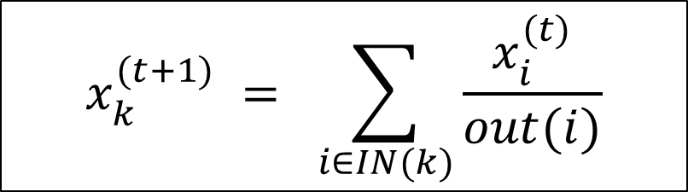
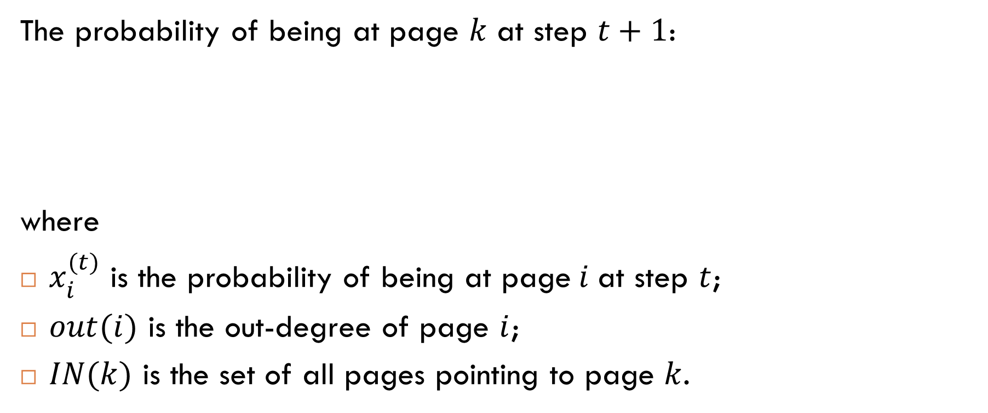
General Recurrence
The probability of being at page $k$ at step $t+1$:
where
$x_{i}^{(t)}$ is the probability of being at page$i$at step $t$;
$out(i)$ is the out-degree of page $i$;
$IN(k)$ is the set of all pages pointing to page $k$.
$$x_{k}^{(t+1)} = \sum_{i∈IN(k)}{\frac{x_{i}^{(t)}}{out(i)}}$$
Similar recurrences occur in Markov
chains.

Slide 8
Markov Chains

Slide 9
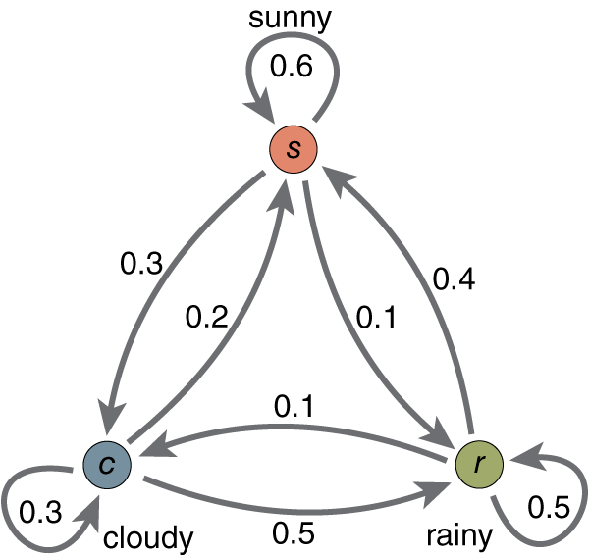
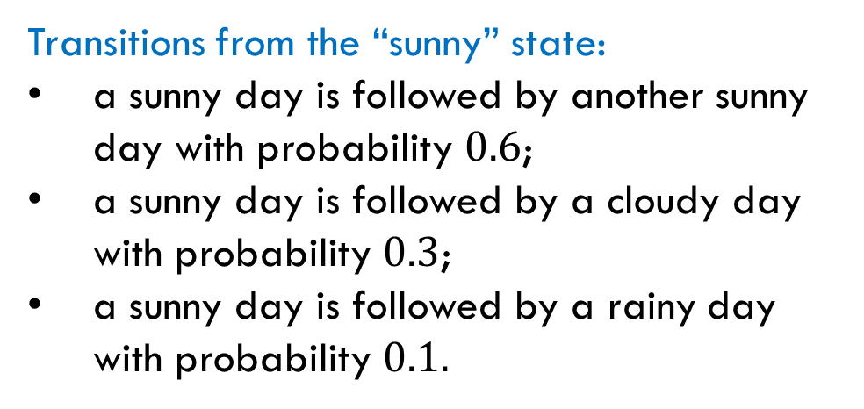
Discrete-Time Random Processes
Example: Three possible states of weather with probabilities of transitions between them.
Transitions from the “sunny” state:
a sunny day is followed by another sunny day with probability $0.6$;
a sunny day is followed by a cloudy day with probability $0.3$;
a sunny day is followed by a rainy day with probability $0.1.$

Slide 10
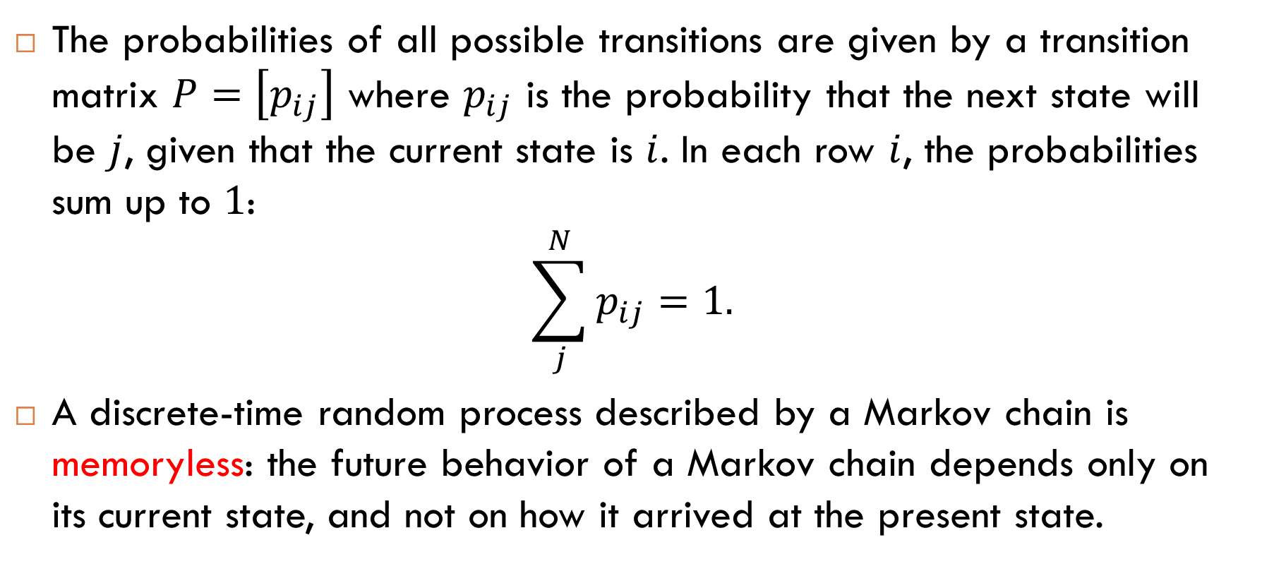
Transition Matrices for Markov Chains
The probabilities of all possible transitions are given by a transition matrix $P=\left[p_{ij}\right]$ where $p_{ij}$ is the probability that the next state will be $j$, given that the current state is $i$. In each row $i$, the probabilities sum up to $1$:
$$\sum_{j}^{N}{p_{ij}}=1.$$
A discrete-time random process described by a Markov chain is memoryless: the future behavior of a Markov chain depends only on its current state, and not on how it arrived at the present state.

Slide 11




Transition Matrix: Example
$$P=\left[\begin{matrix}0.6 & 0.3 & 0.1 \\ 0.2 & 0.3 & 0.5 \\ 0.4 & 0.1 & 0.5\end{matrix}\right]$$
$$1$$
$$2$$
$$3$$

Slide 12
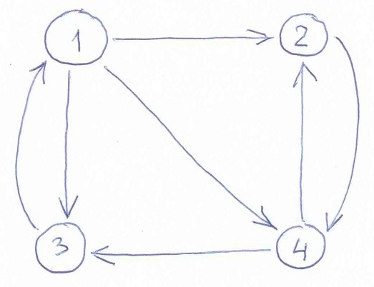

Transition Matrix: Another Example
The random walk on the directed graph below is a Markov chain:
$$P= \left[\begin{matrix}0 & 1/3 & 1/3 & 1/3 \\ 0 & 0 & 0 & 1 \\ 1 & 0 & 0 & 0 \\ 0 & 1/2 & 1/2 & 0\end{matrix}\right]$$

Slide 13
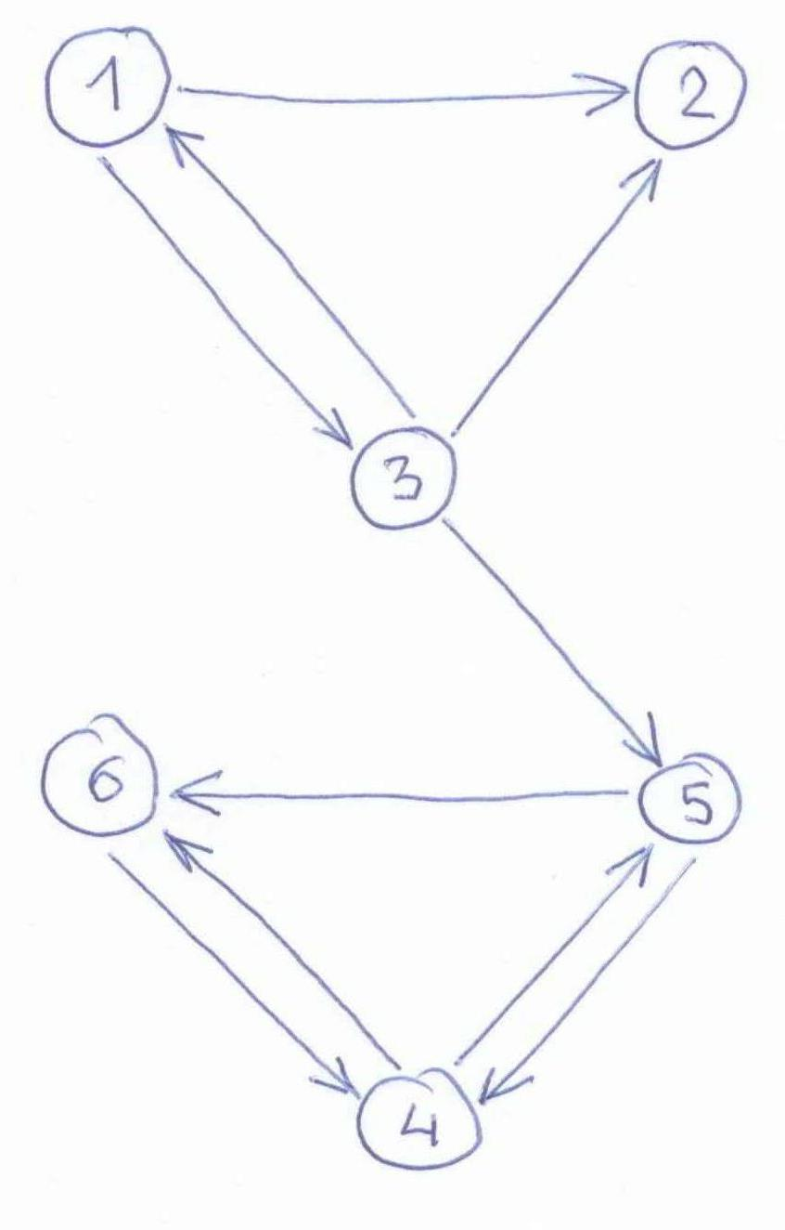
Exercise
Give a transition matrix for the random walk on the directed graph to the right.
Is this random walk a Markov chain?

Slide 14

Exercise: Transition Matrix
Give a transition matrix for the random walk on the directed graph to the right.
$$P= \left[\begin{matrix}0 & 1/2 & 1/2 & 0 & 0 & 0 \\ 0 & 0 & 0 & 0 & 0 & 0 \\ 1/3 & 1/3 & 0 & 0 & 1/3 & 0 \\ 0 & 0 & 0 & 0 & 1/2 & 1/2 \\ 0 & 0 & 0 & 1/2 & 0 & 1/2 \\ 0 & 0 & 0 & 1 & 0 & 0\end{matrix}\right]$$

Slide 15


Exercise: Not a Markov Chain
This random walk is not a Markov chain because node $2$ has no outgoing links (the sum of the entries in the second row is $0$.
$$P=\left[\begin{matrix}0 & 1/2 & 1/2 & 0 & 0 & 0 \\ 0 & 0 & 0 & 0 & 0 & 0 \\ 1/3 & 1/3 & 0 & 0 & 1/3 & 0 \\ 0 & 0 & 0 & 0 & 1/2 & 1/2 \\ 0 & 0 & 0 & 1/2 & 0 & 1/2 \\ 0 & 0 & 0 & 1 & 0 & 0\end{matrix}\right]$$

Slide 16
Stationary Distributions

Slide 17

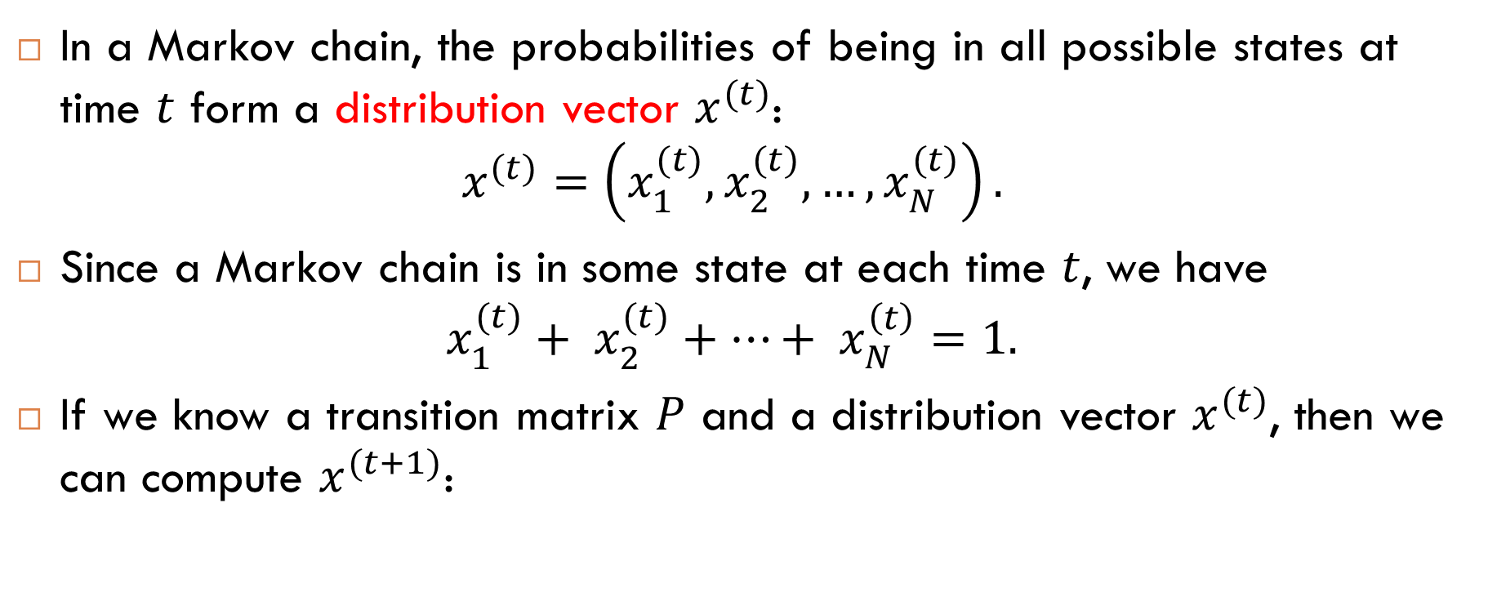
Distribution Vectors
In a Markov chain, the probabilities of being in all possible states at time $t$ form a distribution vector $x^{(t)}$:
$$x^{(t)}=\left(x_{1}^{(t)}, x_{2}^{(t)}, …, x_{N}^{(t)}\right).$$
Since a Markov chain is in some state at each time $t$, we have
$$x_{1}^{(t)}+ x_{2}^{(t)}+…+ x_{N}^{\left(t\right)}=1.$$
If we know a transition matrix $P$ and a distribution vector $x^{(t)}$, then we can compute $x^{(t+1)}$:
$$x^{(t+1)}= x^{(t)} P$$

Slide 18

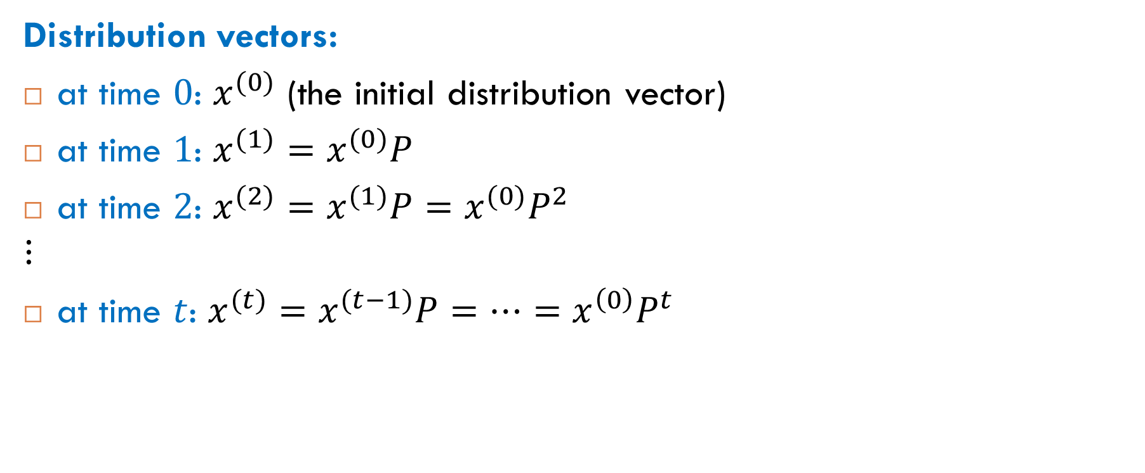
Computation of Distribution Vectors
Distribution vectors:
at time $0$: $x^{(0)}$ (the initial distribution vector)
at time $1$: $x^{(1)}=x^{(0)}P$
at time $2$: $x^{(2)}=x^{(1)}P=x^{(0)}P^{2}$
$$⋮$$
at time $t$: $x^{(t)}=x^{(t−1)}P=…=x^{\left(0\right)}P^{t}$
$$x^{(t)}=x^{(0)}P^{t}$$

Slide 19
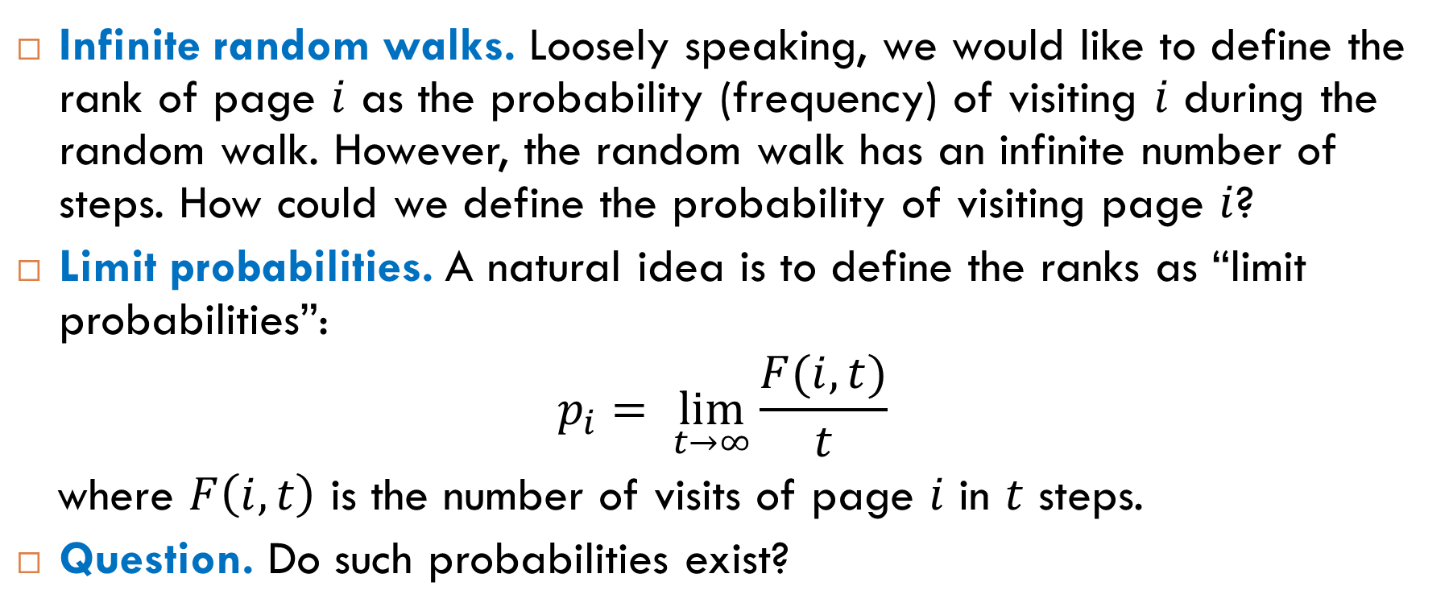
Ranks as Limit Probabilities
Infinite random walks. Loosely speaking, we would like to define the rank of page $i$ as the probability (frequency) of visiting $i$ during the random walk. However, the random walk has an infinite number of steps. How could we define the probability of visiting page $i$?
Limit probabilities. A natural idea is to define the ranks as “limit probabilities”:
$$p_{i}= \lim_{t→∞}{\frac{F(i,t)}{t}}$$
where $F\left(i,t\right)$ is the number of visits of page $i$ in $t$ steps.
Question. Do such probabilities exist?

Slide 20
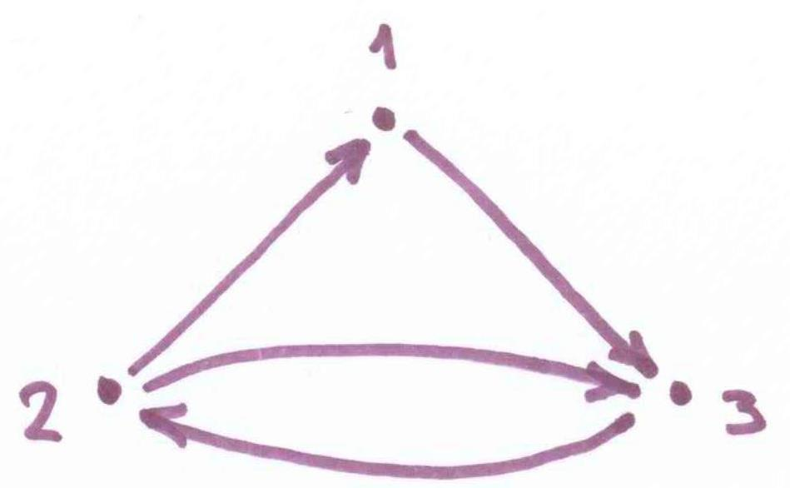
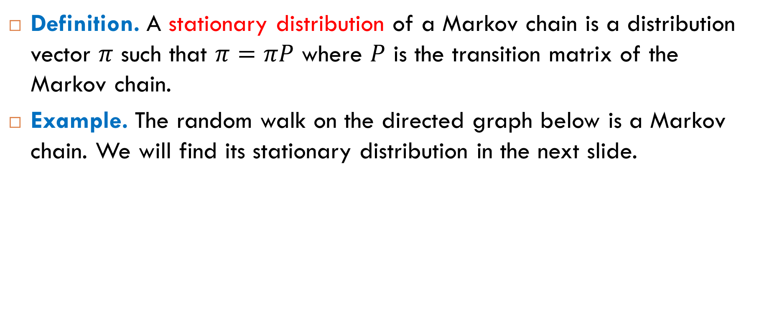
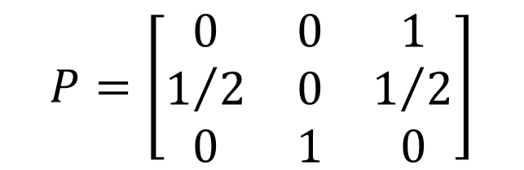
Stationary Distributions
Definition. A stationary distribution of a Markov chain is a distribution vector $π$ such that $π=πP$ where $P$ is the transition matrix of the Markov chain.
Example. The random walk on the directed graph below is a Markov chain. We will find its stationary distribution in the next slide.
$$P=\left[\begin{matrix}0 & 0 & 1 \\ 1/2 & 0 & 1/2 \\ 0 & 1 & 0\end{matrix}\right]$$

Slide 21
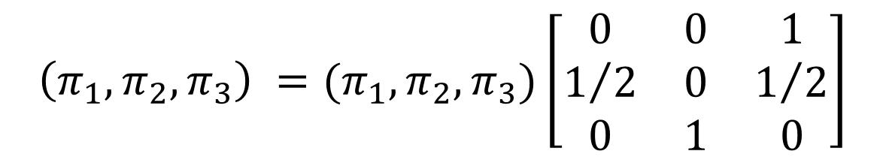

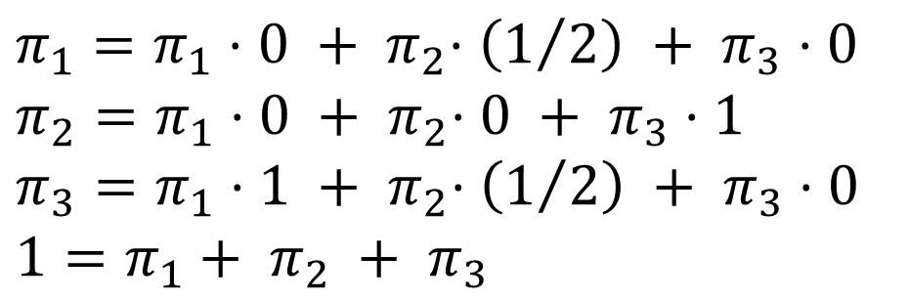
Matrix Equation
We need to find a distribution vector $(π_{1},π_{2},π_{3})$ such that
We can re-write this matrix equation as a system of linear equations:
$$\left(π_{1},π_{2},π_{3}\right) =(π_{1},π_{2},π_{3})\left[\begin{matrix}0 & 0 & 1 \\ 1/2 & 0 & 1/2 \\ 0 & 1 & 0\end{matrix}\right]$$
$$π_{1}=π_{1}⋅0 +{ π}_{2}⋅\left(1/2\right) + π_{3}⋅0$$
$$π_{2}=π_{1}⋅0 +{ π}_{2}⋅0 + π_{3}⋅1$$
$$π_{3}=π_{1}⋅1 +{ π}_{2}⋅\left(1/2\right) + π_{3}⋅0$$
$$1=π_{1}+ π_{2} + π_{3}$$

Slide 22

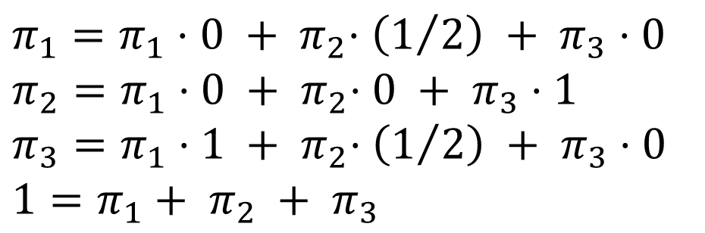
Matrix Equation: Solution
The system of linear equations
has a unique solution:
$$π_{1}=π_{1}⋅0 +{ π}_{2}⋅\left(1/2\right) + π_{3}⋅0$$
$$π_{2}=π_{1}⋅0 +{ π}_{2}⋅0 + π_{3}⋅1$$
$$π_{3}=π_{1}⋅1 +{ π}_{2}⋅\left(1/2\right) + π_{3}⋅0$$
$$1=π_{1}+ π_{2} + π_{3}$$
$$π_{1}=1/5$$
$$π_{2}=2/5$$
$$π_{3}=2/5$$

Slide 23
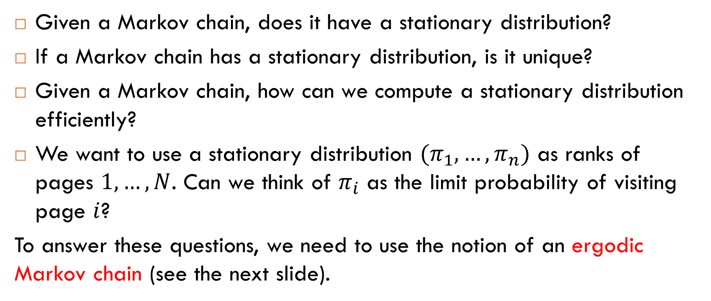
Questions
Given a Markov chain, does it have a stationary distribution?
If a Markov chain has a stationary distribution, is it unique?
Given a Markov chain, how can we compute a stationary distribution efficiently?
We want to use a stationary distribution $(π_{1}, …, π_{n})$ as ranks of pages $1, …, N$. Can we think of $π_{i}$ as the limit probability of visiting page $i$?
To answer these questions, we need to use the notion of an ergodic Markov chain (see the next slide).

Slide 24
Ergodic Markov Chains
Informally: A Markov chain is ergodic if
it is possible to get to any state from any state with nonzero probability (the underlying graph is strongly connected);
there is at least one state that is not periodic.
Examples
ergodic
not ergodic

Slide 25
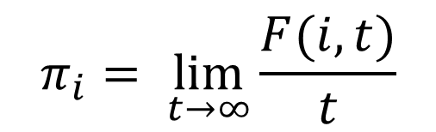
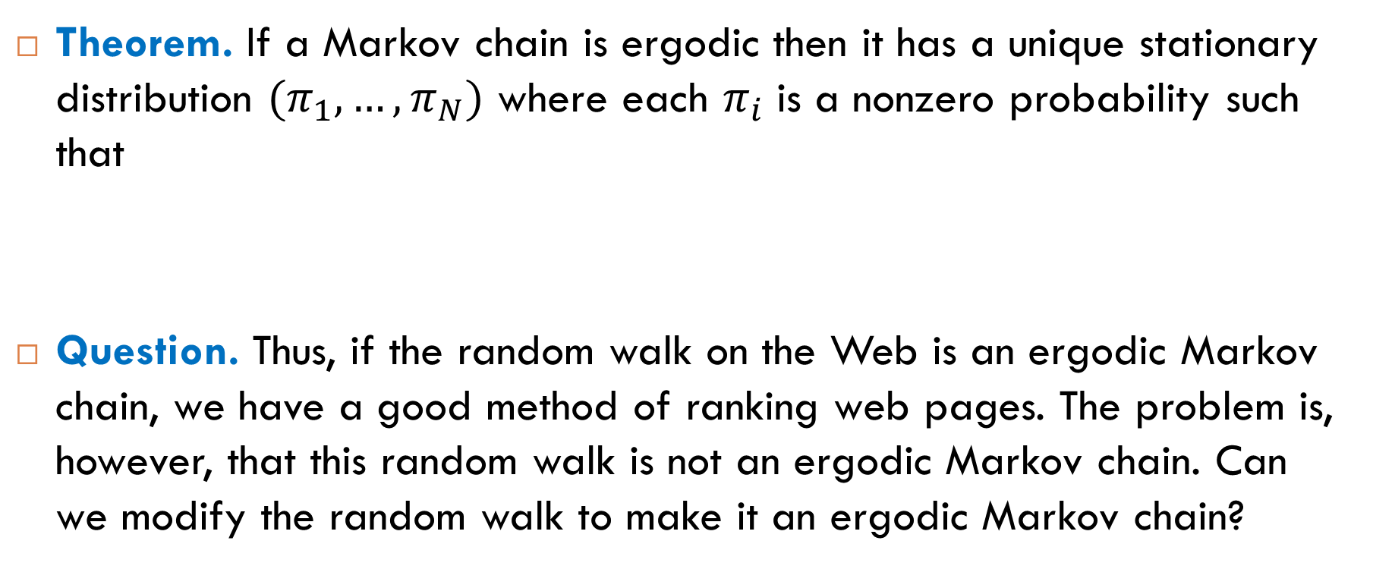
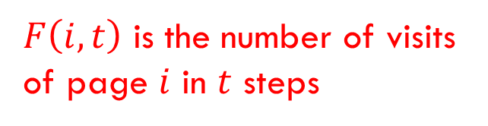
Fundamental Theorem of Markov Chains
Theorem. If a Markov chain is ergodic then it has a unique stationary distribution $(π_{1}, …, π_{N})$ where each $π_{i}$ is a nonzero probability such that
Question. Thus, if the random walk on the Web is an ergodic Markov chain, we have a good method of ranking web pages. The problem is, however, that this random walk is not an ergodic Markov chain. Can we modify the random walk to make it an ergodic Markov chain?
$$π_{i}= \lim_{t→∞}{\frac{F(i,t)}{t}}$$
$F\left(i,t\right)$ is the number of visits of page $i$ in $t$ steps

Slide 26

Reading
Section 7.1.4

